Slide 1
Generative Model Applications
Xue ben 1901213508

Slide 2
Contents
Conditional Generative Model
cGAN
Pix2Pix
CycleGAN
Review
Super Resolution
Pose Guided Image Generation
Interactive GAN

Slide 3
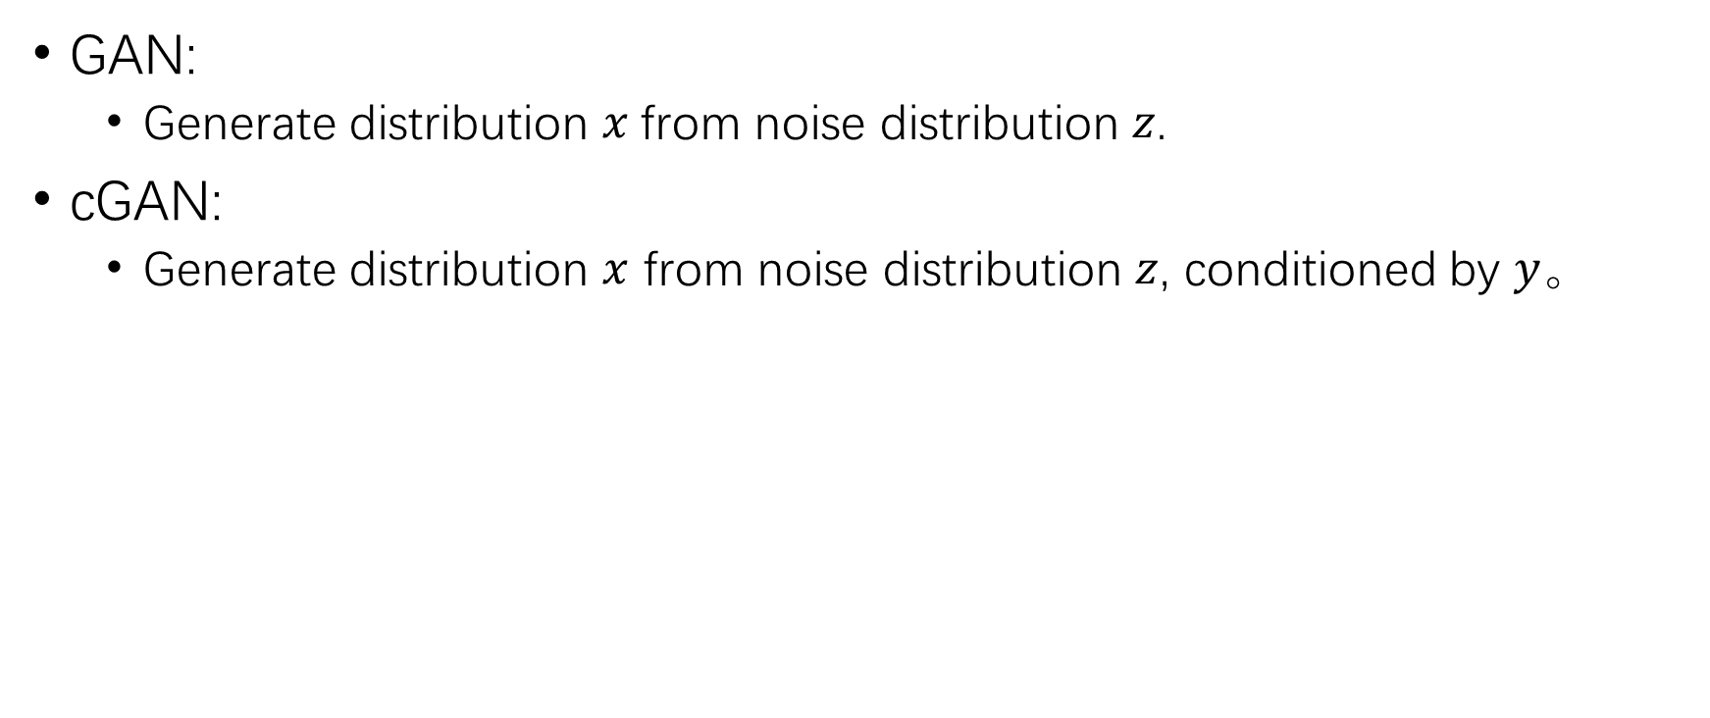
Conditional Generative Adversarial Nets
GAN:
Generate distribution $x$from noise distribution $z$.
cGAN:
Generate distribution $x$ from noise distribution $z$, conditioned by $y。$

Slide 4
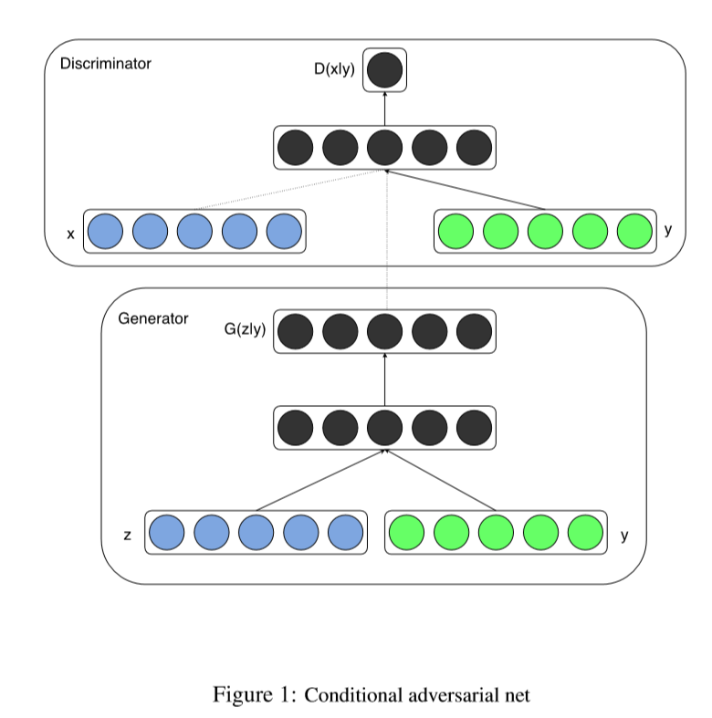

Slide 5
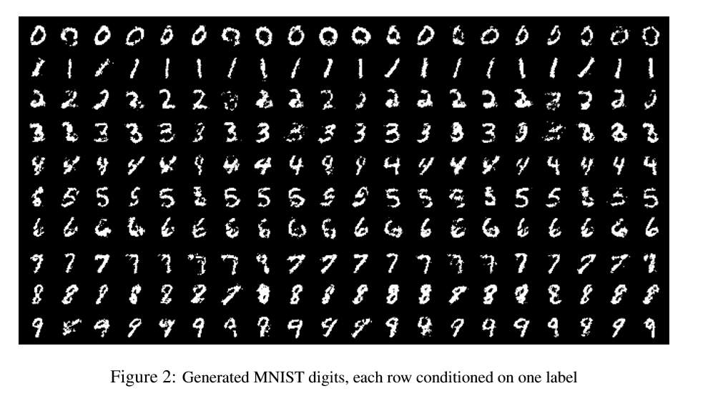
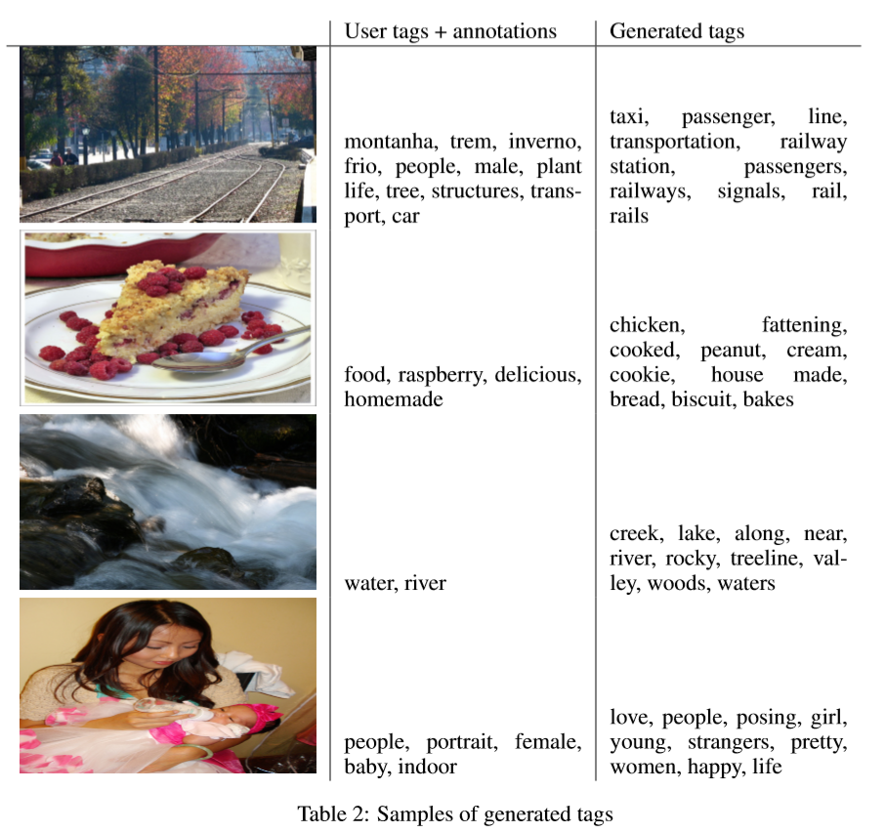
Conditioned by:
Image feature
label

Slide 6
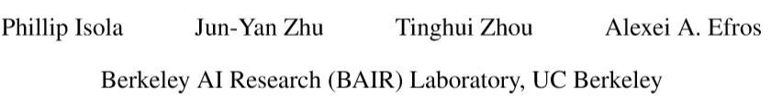
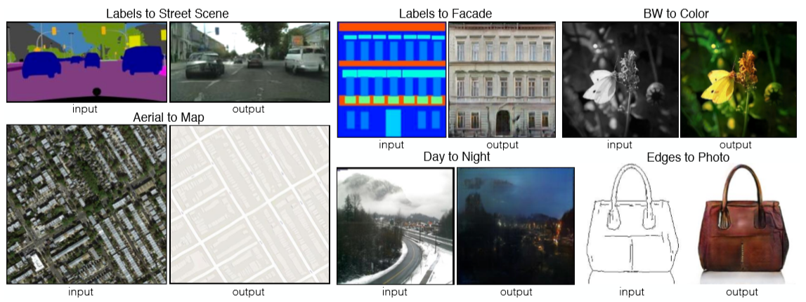
Image-to-image Translation with Conditional Adversarial Networks

Slide 7
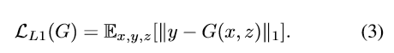
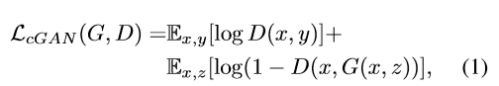
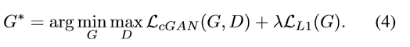
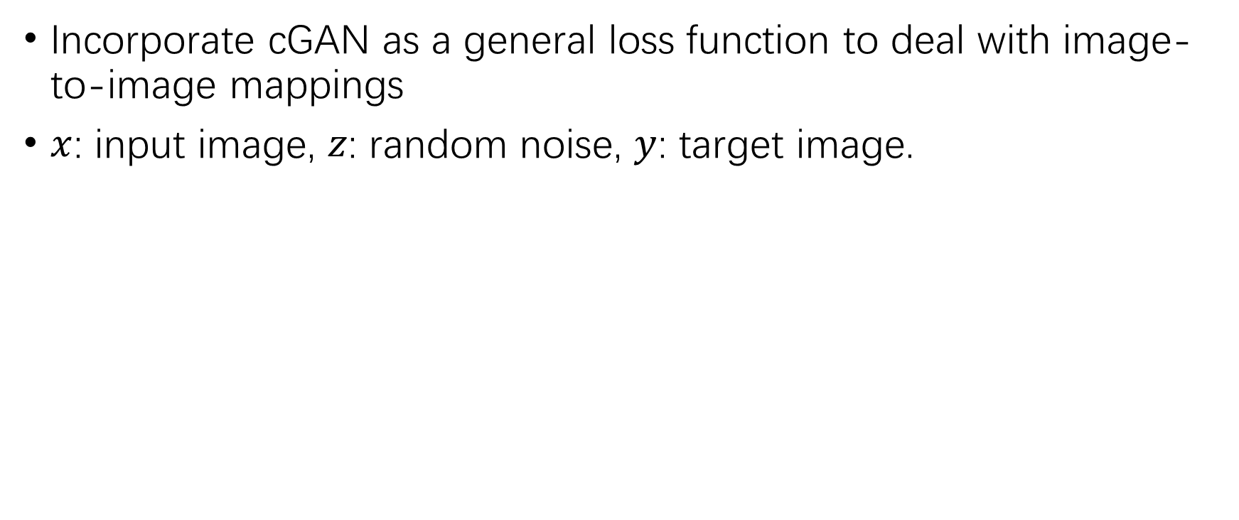
Pix2Pix
Incorporate cGAN as a general loss function to deal with image-to-image mappings
$x$: input image, $z$: random noise, $y$: target image.

Slide 8
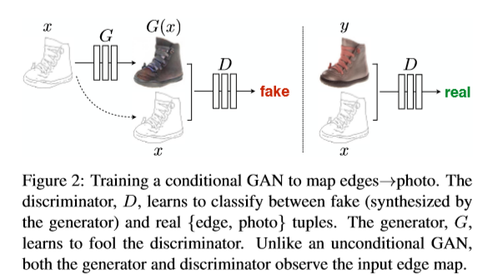
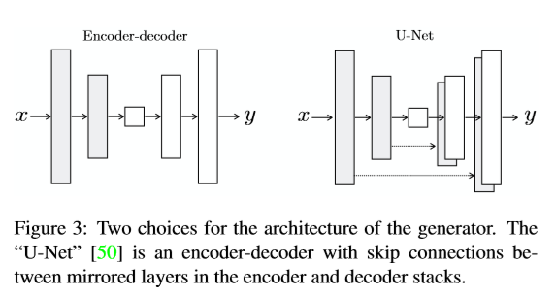
Network Architecture

Slide 9
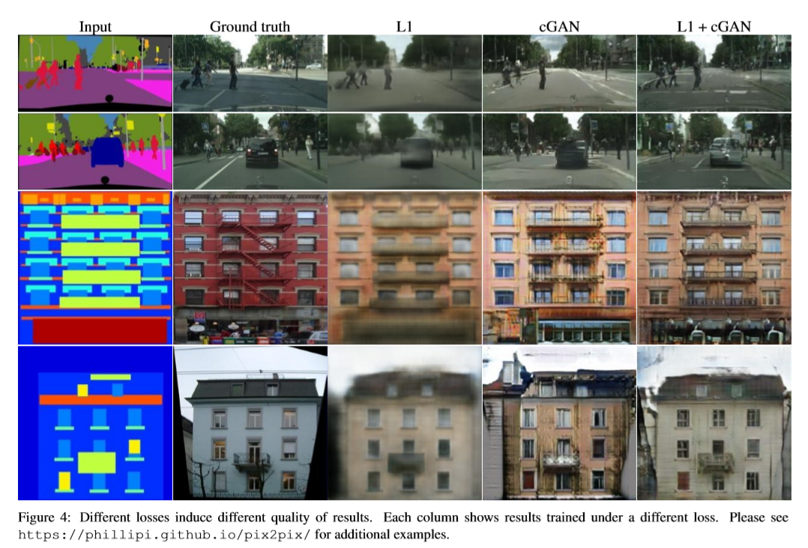

Slide 10
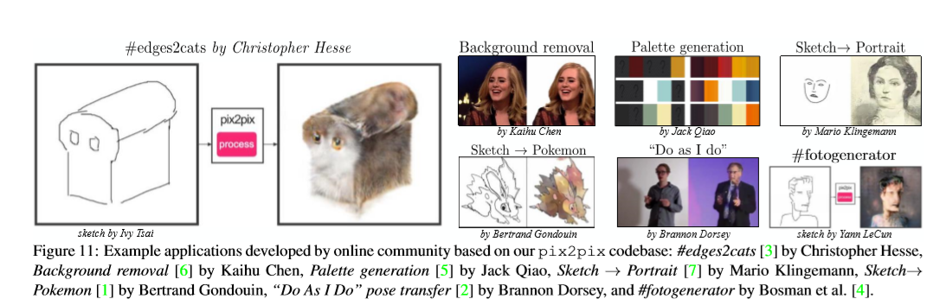
Other Applications

Slide 11
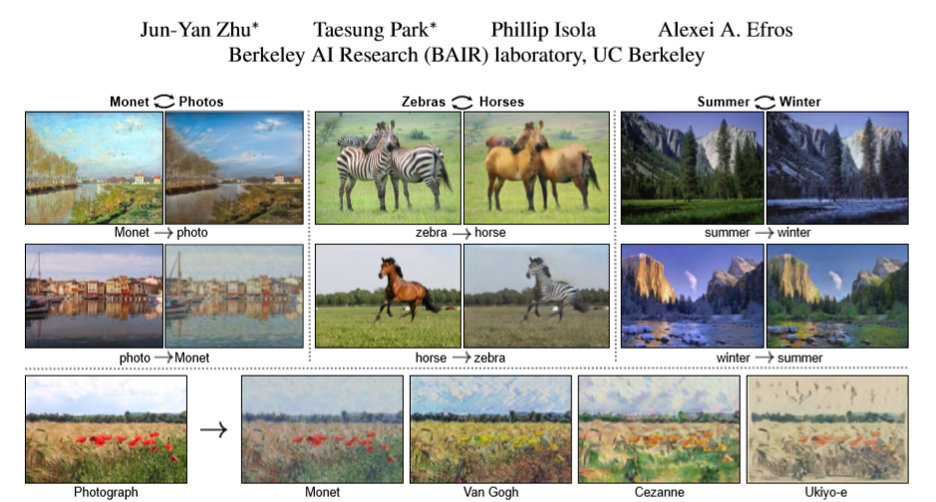
Unpaired Image-to-Image Translation using Cycle-Consistency Adversarial Nets

Slide 12
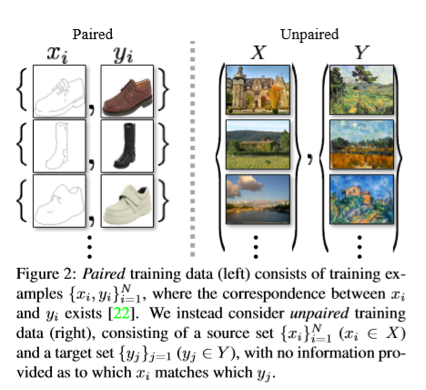
Problem Setting
Difficulty to collect large amount of paired data
How to constraint generative model without supervision loss?

Slide 13
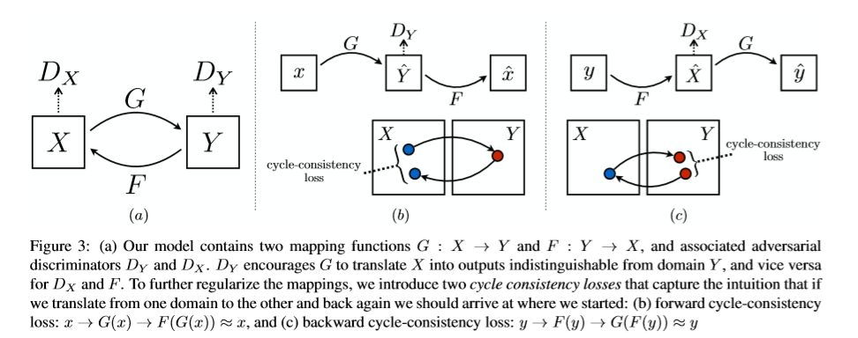
Cycle Consistency

Slide 14
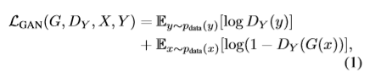
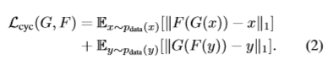
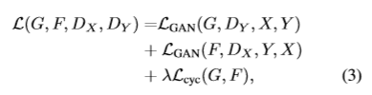
Cycle Consistency

Slide 15
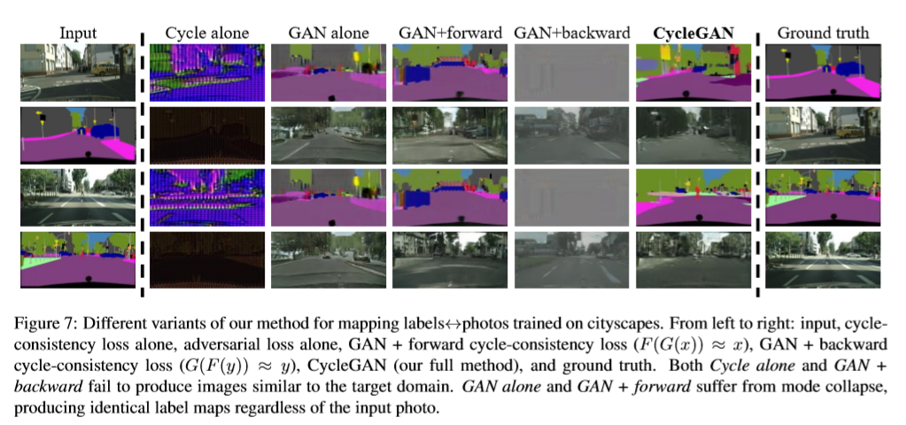
Experiments

Slide 16
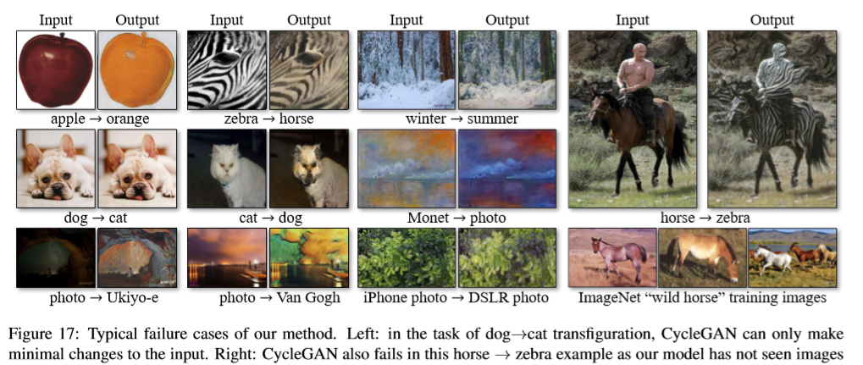
Failure cases
How to deal with domain complexity & loss of information.
Attention on fore/back ground.

Slide 17

Review: Super Resolution

Slide 18
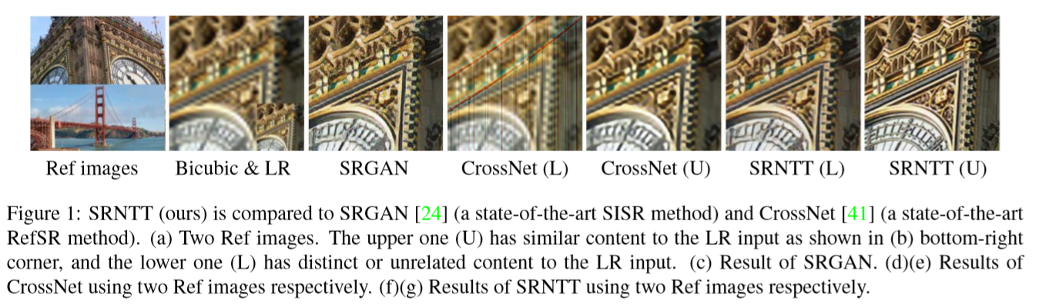
Generate SR image by ‘borrowing’ texture from reference image

Slide 19
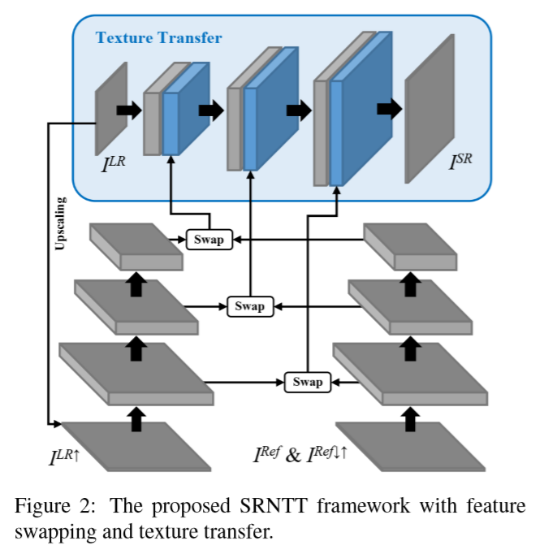
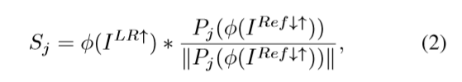
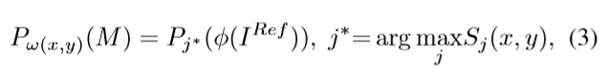
Network Architecture
Feature Swapping

Slide 20
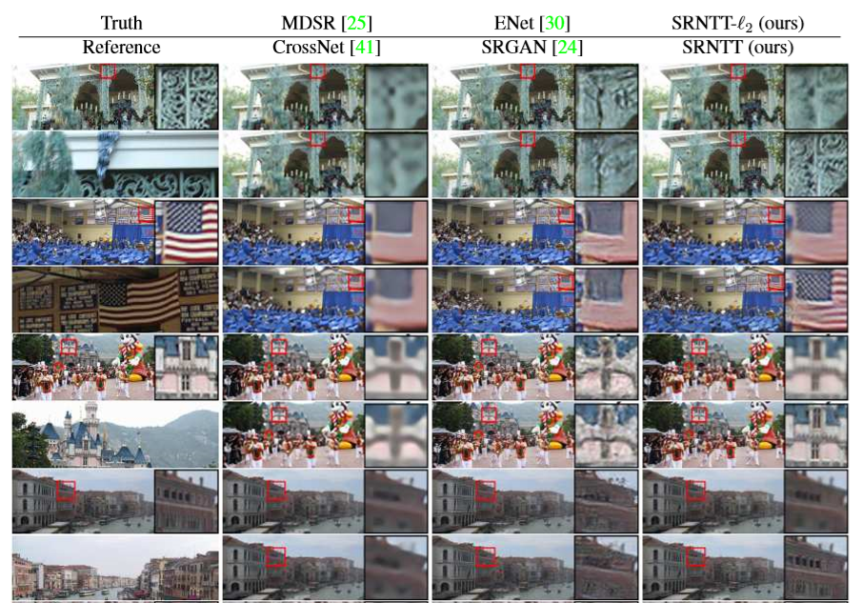

Slide 21
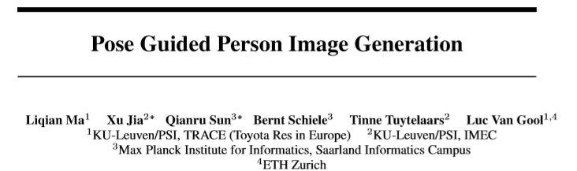
Review: Pose Guided Image Generation

Slide 22
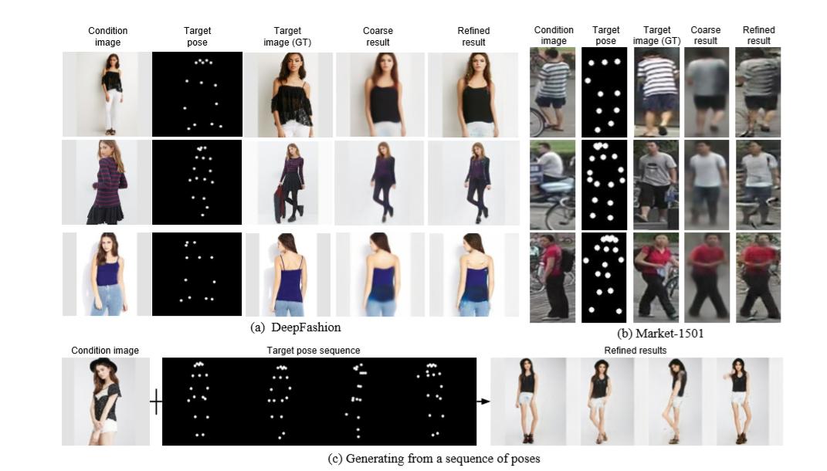
Disentangle image to style & pose

Slide 23
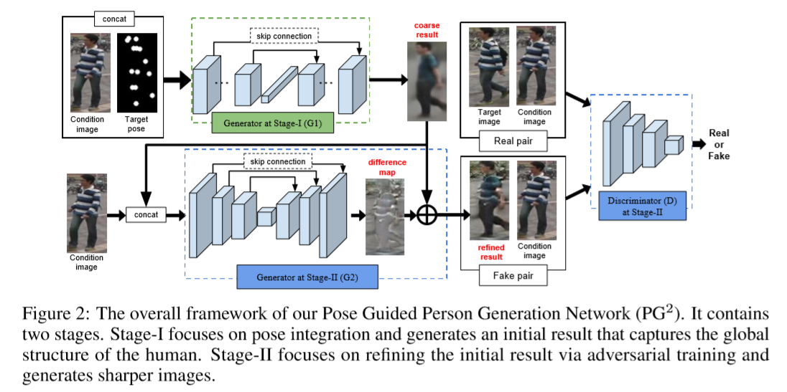
Network Architecture

Slide 24
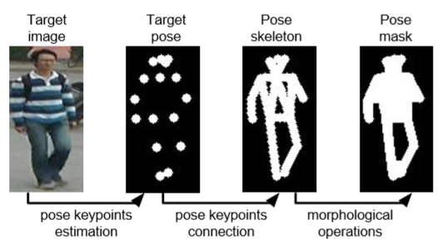
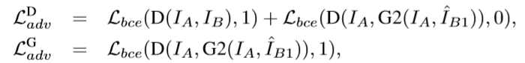
Network Architecture
Stage I: pose integration
Focus on target image foreground by constraint of pose mask.
Stage II: refinement

Slide 25
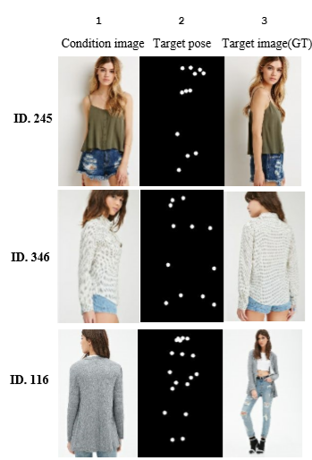
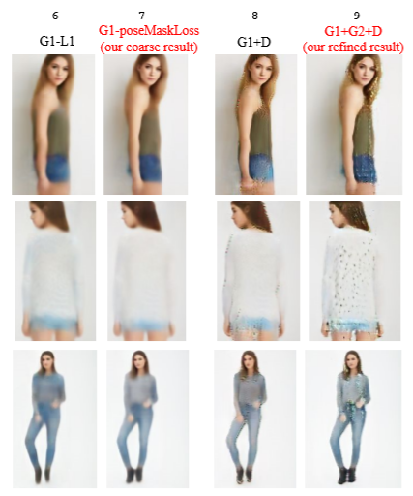
Experiments

Slide 26
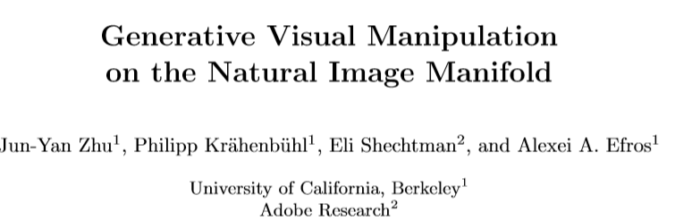
Review: Interactive GAN

Slide 27
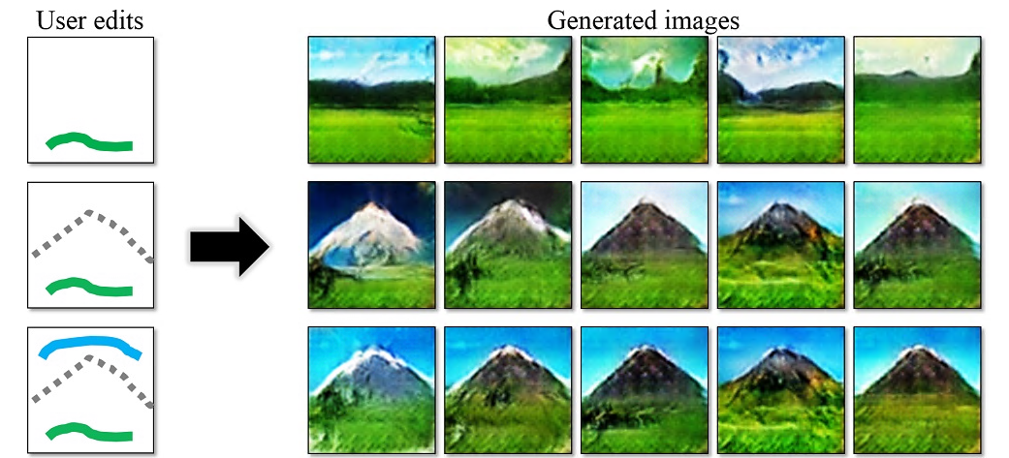
Interaction with user edits in real-time

Slide 28
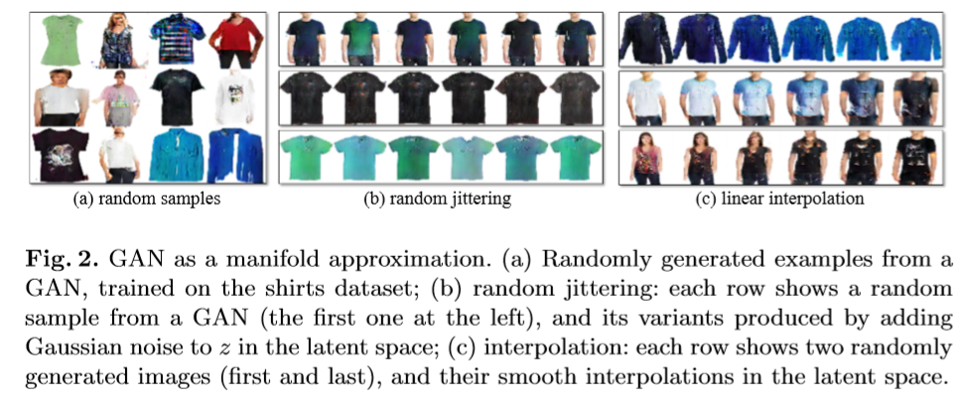
GAN as manifold
Locally Euclidean
Latent space manipulation can produce reasonable results

Slide 29
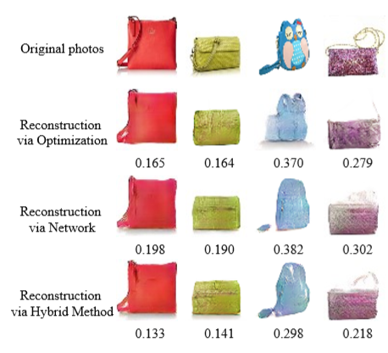
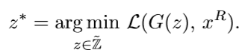
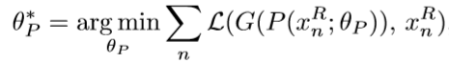
Projection
Solve by:
Optimization
Feed-forward Network
Hybrid

Slide 30
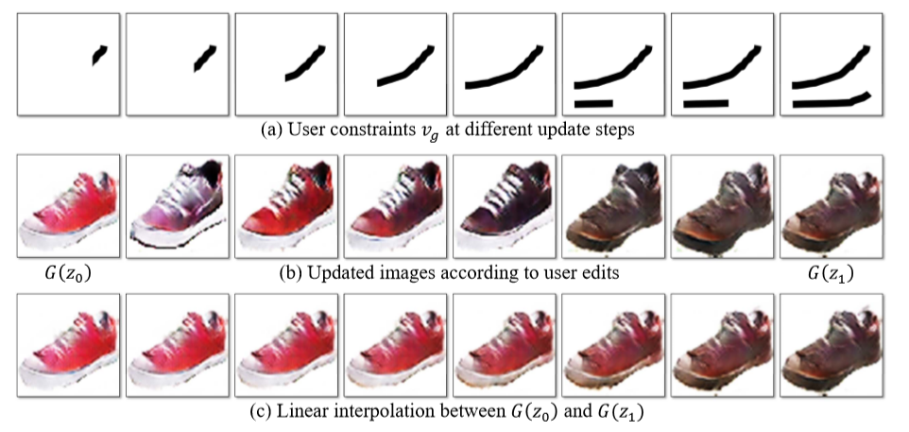
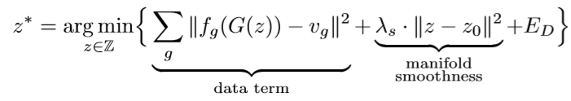
Manipulation
Define several operations:
Coloring
Sketching
Warping
Solve by optimization(GD)

Slide 31
Reference
Conditional Generative Adversarial Nets
Image-to-Image Translation with Conditional Adversarial Networks
Unpaired Image-to-Image Translation using Cycle-Consistent Adversarial Networks
Pose Guided Person Image Generation
Image Super-Resolution by Neural Texture Transfer
Generative Visual Manipulation on the Natural Image Manifold

